Slide 1
Mocking made easy

Slide 2
Or, as I like to call it...

Slide 3




$$$ Mocking and glocking $$$

Slide 4
Some disclaimers
I am going to pimp a library that I wrote
I’m really hoping you will place this in the top 3 talks of the night

Slide 5
Me
Dave
dave@davecooper.org
github.com/grug
Dev
OVO
Some quotes to verify I am who I say I am:
“Dave? Yeah, I know him - he’s a dev at OVO” - Someone, probably.
“Dave is the best dev on the planet” - My Mother, all the time.
“I literally cannot believe I sat through that garbage talk” - You, in about 25 minutes.

Slide 6
THIS IS HOW THE NEXT 25 MINUTES OR SO ARE GOING TO GO DOWN
I will talk about:
An ideal scenario for running/testing web apps locally
What I think the problem is
What some of our options are
What I think a reasonable solution is
You will:
Hopefully have a good time
Laugh/cry/love

Slide 7
Ideally...
Running an app locally is painless
Mocking API responses is painless
Application state is flexible, but deterministic

Slide 8
The problem...
A lot of the time it isn’t
This makes me sad :(
Let’s talk about that

Slide 9
How have we seen data injected into applications locally before?

Slide 10
Run the app against a production service

Slide 11
No. That’s naughty. That will get you sent to developer jail.

Slide 12
Run the app against a staging service

Slide 13
No. That’s also naughty. You will also get sent to developer jail if you do this.

Slide 14
Run the app against a local copy of a staging service

Slide 15
That’s slightly less naughty…
But still naughty. You might not go to developer jail if you do this - but you also might.
It’s also a pain.

Slide 16
Show of hands...
Who here has worked on a project where any of these things are done?

Slide 17
Things I like
Things I don’t like
Peanut butter
Pizza
Writing meaningful code
Having fun while doing and eating all of the above
Data stores and backend services, when writing front end code

Slide 18
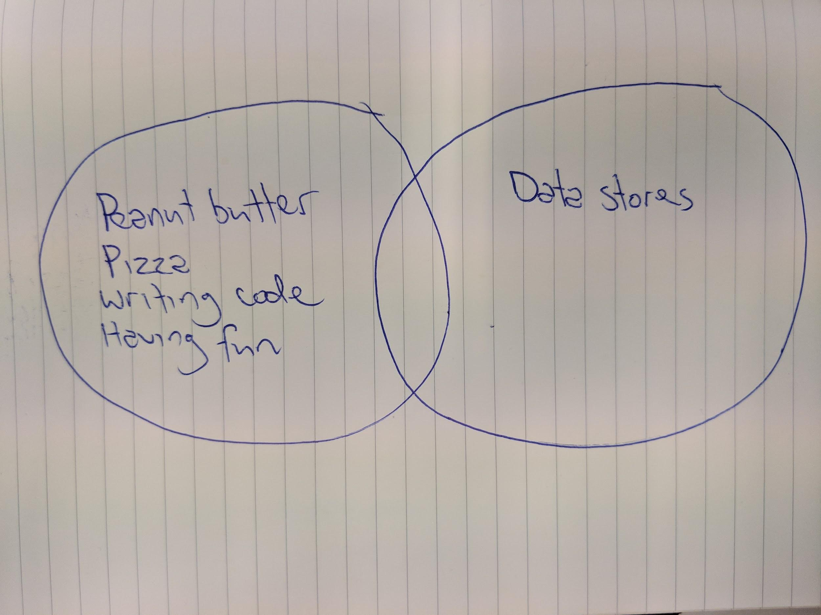
The previous slide, but in Venn diagram form

Slide 19
Running a mock API server locally
Ok - now we’re getting somewhere...
Loads of options to choose from…
json-server
node-mock-server
apimocker
… or one of the 600,000,000,000,000 alternatives
Or you could even roll your own local API that returns canned responses

Slide 20
What some of these look like
json-server...
// ... in db.json { "next-shift": { "shiftSize": "large" } }
// ... from command line json-server --watch db.json
Notes:
No need to modify application code: as long as there is a mock endpoint that matches what your application calls, it will return mocked data

Slide 21
What some of these look like
api-mocker - https://github.com/gstroup/apimocker

Slide 22
What else can we do?
I’m glad you asked...
Notes:
As you can see by now - I am a bit frustrated with this

Slide 23


Slide 24
data-mocks
Uses a code driven config to define endpoints we want to mock, and their respective responses
Scenario support! ← more on this in a little bit
Doesn’t interfere with your existing code
Similar to angular-multimocks, but framework agnostic
Even works with React Native
Works with XHR and Fetch
Light and easy to set up

Slide 25
Now for the part where my talk falls apart...
Let’s do some live coding

Slide 26
What can data-mocks do for integration tests?
data-mocks makes running integration tests quite nice
Scenarios allow for easy coverage of use/edge cases
Notes:
Not going to go into Cypress too much, since

Slide 27
Things data-mocks still needs (or so I think...)
Logging
e.g. Dump all mocked request info like query string params/POST body/request headers into the console for debugging purposes
Since requests won’t show up in the network tab, some sort of logging middleware would be nice

Slide 28
Things data-mocks still needs (or so I think...)
Passthrough
At the moment, all request endpoints must have a matching mock or data-mocks will have a cry at you
Ideally, there would be a way to tell it not to cry if you didn’t mind actual endpoints getting hit for certain requests
xhr-mock can do this easily - fetch-mock will be slightly trickier...

Slide 29
Things data-mocks still needs (or so I think...)
Simulation of paginated data
This one is pretty self-explanatory… it would be rad to have
No reason this can’t be implemented pretty easily

Slide 30
Things data-mocks still needs (or so I think...)
More users to test it!
At the moment, the library gets up to 500 downloads a week, but I’m sure there are loads of use/edge cases that I haven’t even thought of yet!

Slide 31
Useful links
Tonight’s code: https://github.com/grug/mocking-made-easy-code
data-mocks: https://github.com/ovotech/data-mocks
fetch-mock : https://github.com/wheresrhys/fetch-mock
xhr-mock: https://github.com/jameslnewell/xhr-mock
json-server: https://github.com/typicode/json-server
node-mock-server: https://github.com/smollweide/node-mock-server
apimocker: https://github.com/gstroup/apimocker

Slide 32
This is the end of my talk
Please clap and cheer loudly.

Slide 33
??? Questions ???

